Slide 1
ISA5577 Applied Quantitative Methods for Human-Computer Interaction
人機互動量化研究方法
May 18, 2015
Hao-Chuan Wang

Slide 2
Today’s Agenda
Machine Learning Evaluation
Sources & Content Credits:
Witten and Frank. http://www.cs.waikato.ac.nz/ml/weka/book.html
Stanford CS 276. Information Retrieval and Web Search. http://web.stanford.edu/class/cs276/
All materials are obtained from the internet and reused under the term of fair use for
the sole purpose of education.

Slide 3
Credibility: Evaluating What’s Been Learned
Issues: training, testing, tuning
Holdout, cross-validation
Confusion matrix
Evaluating numeric prediction

Slide 4
Evaluation: the key to success
How predictive is the model we learned?
Error on the training data is not a good indicator of performance on future data
  Otherwise 1-NN (Nearest Neighbor) would be the optimum classifier!
Simple solution that can be used if lots of (labeled) data is available:
  Split data into training and test set
However: (labeled) data is usually limited
  More sophisticated techniques need to be used

Slide 5
Issues in Evaluation
Choice of performance measure:
  Number of correct classifications
  Error in numeric predictions
Costs assigned to different types of errors
Many practical applications involve costs

Slide 6
Training and Testing I
Natural performance measure for classification problems: error rate
  Success: instance’s class is predicted correctly
  Error: instance’s class is predicted incorrectly
  Error rate: proportion of errors made over the whole set of instances
Resubstitution error: error rate obtained from training data
  Resubstitution error is (hopelessly) optimistic!

Slide 7
Training and Testing II
Test set: independent instances that have played no part in formation of classifier
  Assumption: both training data and test data are representative samples of the underlying problem
Test and training data may differ in nature
  Example: classifiers built using customer data from two different towns A and B
  To estimate performance of classifier from town A in completely new town, test it on data from B

Slide 8
Making the most of the data
Once evaluation is complete, all the data can be used to build the final classifier
Generally, the larger the training data the better the classifier (but returns diminish)
The larger the test data the more accurate the error estimate
Holdout procedure: method of splitting original data into training and test set
  Dilemma: ideally both training set and test set should be large!

Slide 9
Holdout estimation
What to do if the amount of data is limited?
The holdout method reserves a certain amount for testing and uses the remainder for training
  Usually: one third for testing, the rest for training
Problem: the samples might not be representative
  Example: class might be missing in the test data
Advanced version uses stratification
  Ensures that each class is represented with approximately equal proportions in both subsets

Slide 10
Repeated holdout method
Holdout estimate can be made more reliable by repeating the process with different subsamples
  In each iteration, a certain proportion is randomly selected for training (possibly with stratificiation)
  The error rates on the different iterations are averaged to yield an overall error rate
This is called the repeated holdout method
Still not optimum: the different test sets overlap
  Can we prevent overlapping?

Slide 11
Cross-validation
Cross-validation avoids overlapping test sets
  First step: split data into k subsets of equal size
  Second step: use each subset in turn for testing, the remainder for training
Called k-fold cross-validation
Often the subsets are stratified before the cross- validation is performed
The error estimates are averaged to yield an overall error estimate

Slide 12
More on cross-validation
Standard method for evaluation: stratified ten-fold cross- validation
Why ten?
  Extensive experiments have shown that this is the best choice to get an accurate estimate
  There is also some theoretical evidence for this
Stratification reduces the estimate’s variance
Even better: repeated stratified cross-validation
  E.g. ten-fold cross-validation is repeated ten times and results are averaged (reduces the variance)

Slide 13
Leave-One-Out cross-validation
Leave-One-Out:
a particular form of cross-validation:
  Set number of folds to number of training instances
  I.e., for n training instances, build classifier n times
Makes best use of the data
Involves no random subsampling
Very computationally expensive

Slide 14
Leave-One-Out-CV and stratification
Disadvantage of Leave-One-Out-CV: stratification is not possible
  It guarantees a non-stratified sample because there is only one instance in the test set!
Extreme example: random dataset split equally into two classes
  Best inducer predicts majority class
  50% accuracy on fresh data
  Leave-One-Out-CV estimate is 100% error!

Slide 15
Comparing data mining schemes
Frequent question: which of two learning schemes performs better?
Note: this is domain dependent!
Obvious way: compare 10-fold CV estimates
Generally sufficient in applications (we don't loose if the chosen method is not truly better)
However, what about machine learning research?
  Need to show convincingly that a particular method works better

Slide 16
Comparing schemes II
Want to show that scheme A is better than scheme B in a particular domain
Let's assume we have an infinite amount of data from the domain:
  Sample many dataset of specified size
  Obtain cross-validation estimate on each dataset for each scheme
  Check if mean accuracy for scheme A is better than mean accuracy for scheme B

Slide 17
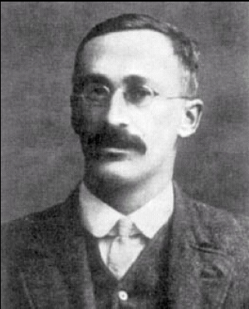
Paired t-test
In practice we have limited data and a limited number of estimates for computing the mean
Student’s t-test tells whether the means of two samples are significantly different
In our case the samples are cross-validation estimates for different datasets from the domain
Use a paired t-test because the individual samples are paired
  The same CV is applied twice
William Gosset
Born: 1876 in Canterbury; Died: 1937 in Beaconsfield, England
Obtained a post as a chemist in the Guinness brewery in Dublin in 1899.
Invented the t-test to handle small samples for quality control in brewing.
Wrote under the name "Student".

Slide 18
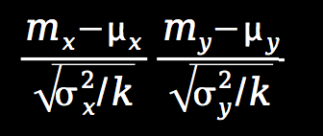
Distribution of the means
x₁ x₂ ...x_{k} and y₁ y₂ ...y_{k} are the 2k samples for the k different datasets
m_{x} and m_{y} are the means
With enough samples, the mean of a set of independent samples is normally distributed
Estimated variances of the means are
σ_{x}²/k and σ_{y}²/k
If μ_{x} and μ_{y} are the true means then
are approximately normally distributed with mean 0, variance 1

Slide 19
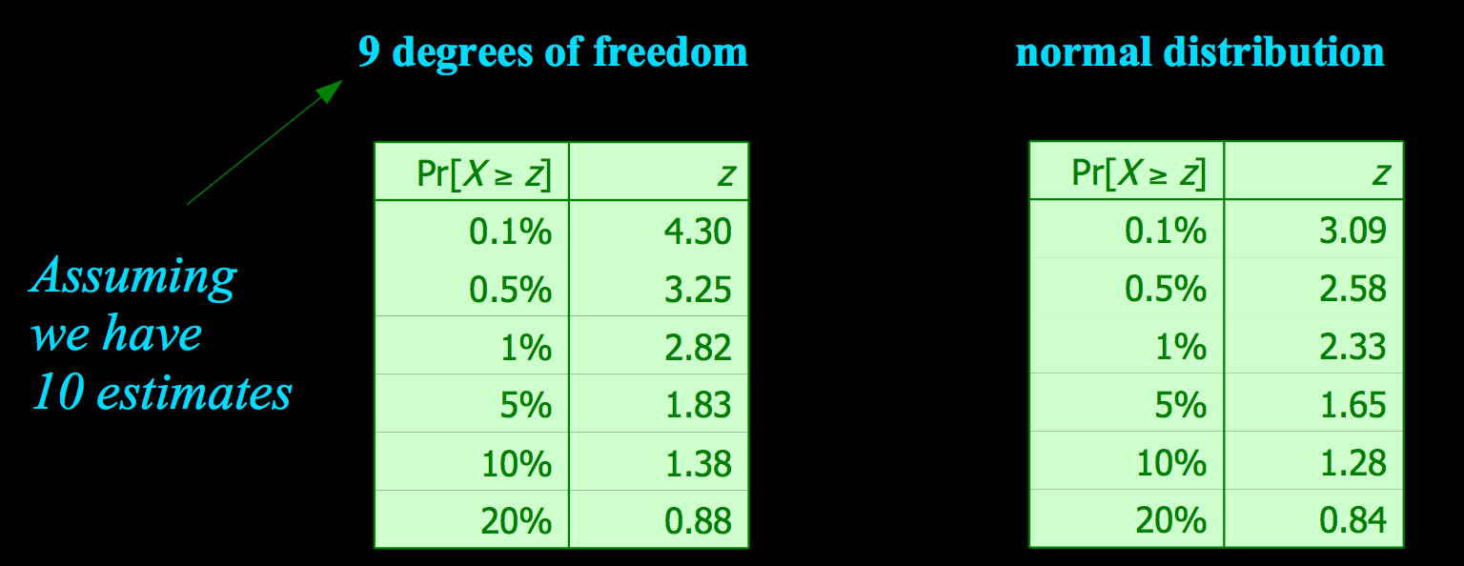
Student’s distribution
With small samples (k < 100) the mean follows Student’s distribution with k–1 degrees of freedom

Slide 20
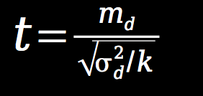
Distribution of the differences
Let m_{d}=m_{x}–m_{y}
The difference of the means (m_{d}) also has a Student’s distribution with k–1 degrees of freedom
Let σ_{d}² be the variance of the difference
The standardized version of m_{d} is called the t-statistic:
We use t to perform the t-test

Slide 21
Performing the test
Fix a significance level
If a difference is significant at the α% level, there is a (100-α)% chance that the true means differ
Divide the significance level by two because the test is two-tailed
Look up the value for z that corresponds to α/2
If t ≤ –z or t ≥z then the difference is significant
  I.e. the null hypothesis (that the difference is zero) can be rejected

Slide 22
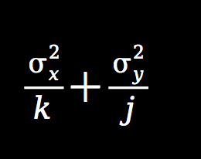
Unpaired observations
If the CV estimates are from different datasets, they are no longer paired
(or maybe we have k estimates for one scheme, and j estimates for the other one)
Then we have to use an un paired t-test with min(k , j) – 1 degrees of freedom
The estimate of the variance of the difference of the means becomes:

Slide 23
Confusion matrix
The confusion matrix:
 |  | True Class
 |  | Yes | No
Predicted Class | Yes | True positive | False positive (“false alarm”)
 | No | False negative | True negative

Slide 24
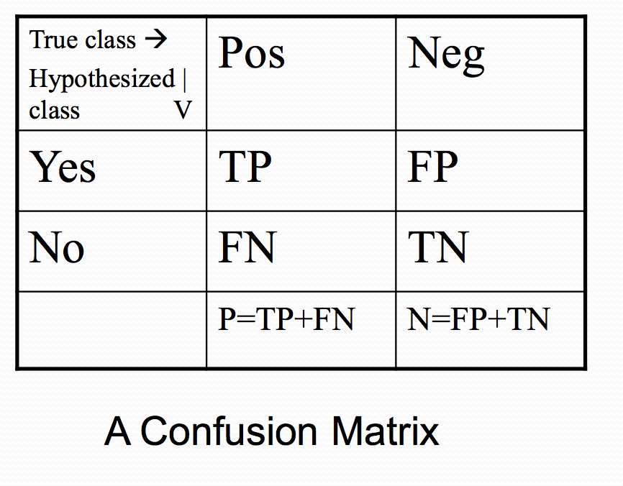
Confusion matrix-based performance measures
Accuracy =
(TP+TN)/(P+N)
Precision = TP/(TP+FP)
Recall (TP Rate) = TP/P
FP Rate= FP/N
ROC Analysis: Moves the threshold between the positive and negative class from a small FP rate to a large one. It plots the value of the Recall against that of the FP Rate at each FP Rate considered.

Slide 25
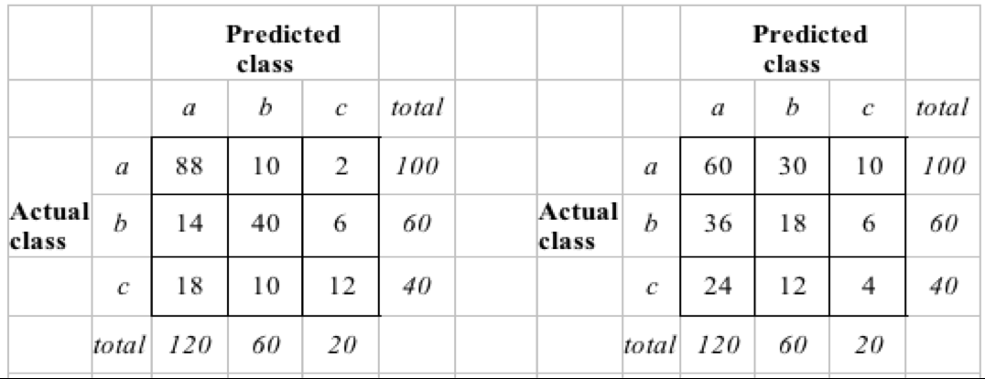
The Kappa Statistic
Supposed we have two confusion matrices for a 3-class problem: actual predictor (left) vs. random predictor (right)
Kappa statistic measures relative improvement over random predictor

Slide 26
Cohen’s Kappa
Measure of agreement
Simple agreement: (a+d)/N
The above does not take account of agreement by chance
Kappa takes account of chance agreement
 |  | Classification 1 (OR OBSERVER 1)
 |  | Positive | Negative | Total
Classification 2 (OR OBSERVER 2) | Positive | a | b | a+b
 | Negative | c | d | c+d
 | Total | a+c | b+d | a+b+c+d

Slide 27
Cohen’s Kappa:
 |  | Classification 1 (OR OBSERVER 1)
 |  | Positive | Negative | Total
Classification 2 (OR OBSERVER 2) | Positive | a | b | a+b
 | Negative | c | d | c+d
 | Total | a+c | b+d | a+b+c+d

Slide 28
Kappa Interpretation
Kappa | Agreement
<0.20 | Poor
0.21-0.40 | Slight
0.41-0.60 | Moderate
0.61-0.80 | Good
0.80-1.00 | Very good

Slide 29
In-Class Practice
Form two-person group
Use t-test to compare the performance of learning algorithms on cross-validation estimates

